Slide 1

Compliance Management and Reporting
Understanding Compliance Processes and Documentation Requirements
INTERNATIONAL CYBERSECURITY AND DIGITAL FORENSICS ACADEMY (ICDFA)
Governance, Compliance, and Risk (GCR)
Course 1: GRC101
Introduction to Governance, Risk, and Compliance

Slide 2


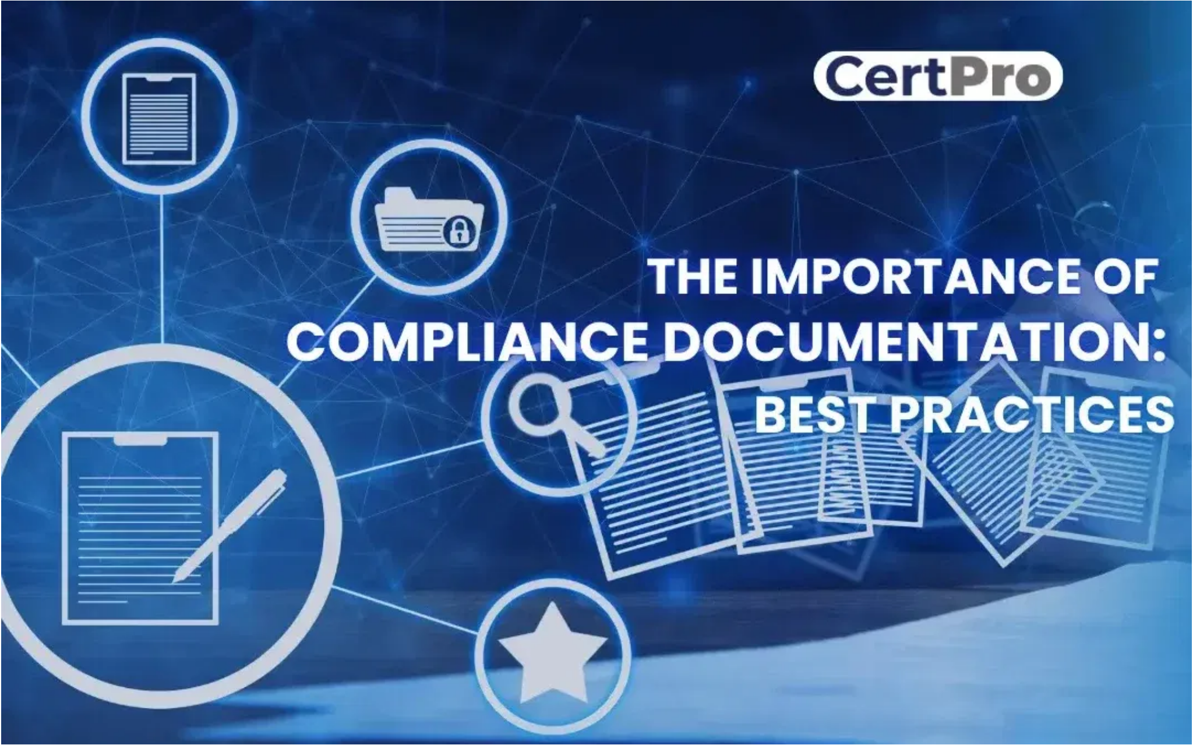





Learning Objectives
By the end of Week 4, you will be able to:
Define and explain the key components of a compliance management system
Identify and describe the seven elements of an effective compliance program
Understand compliance documentation requirements and management best practices
Apply appropriate methodologies for compliance monitoring and auditing
Develop effective compliance reports using appropriate metrics and KPIs
Evaluate and select appropriate tools and technologies for compliance reporting

Slide 3
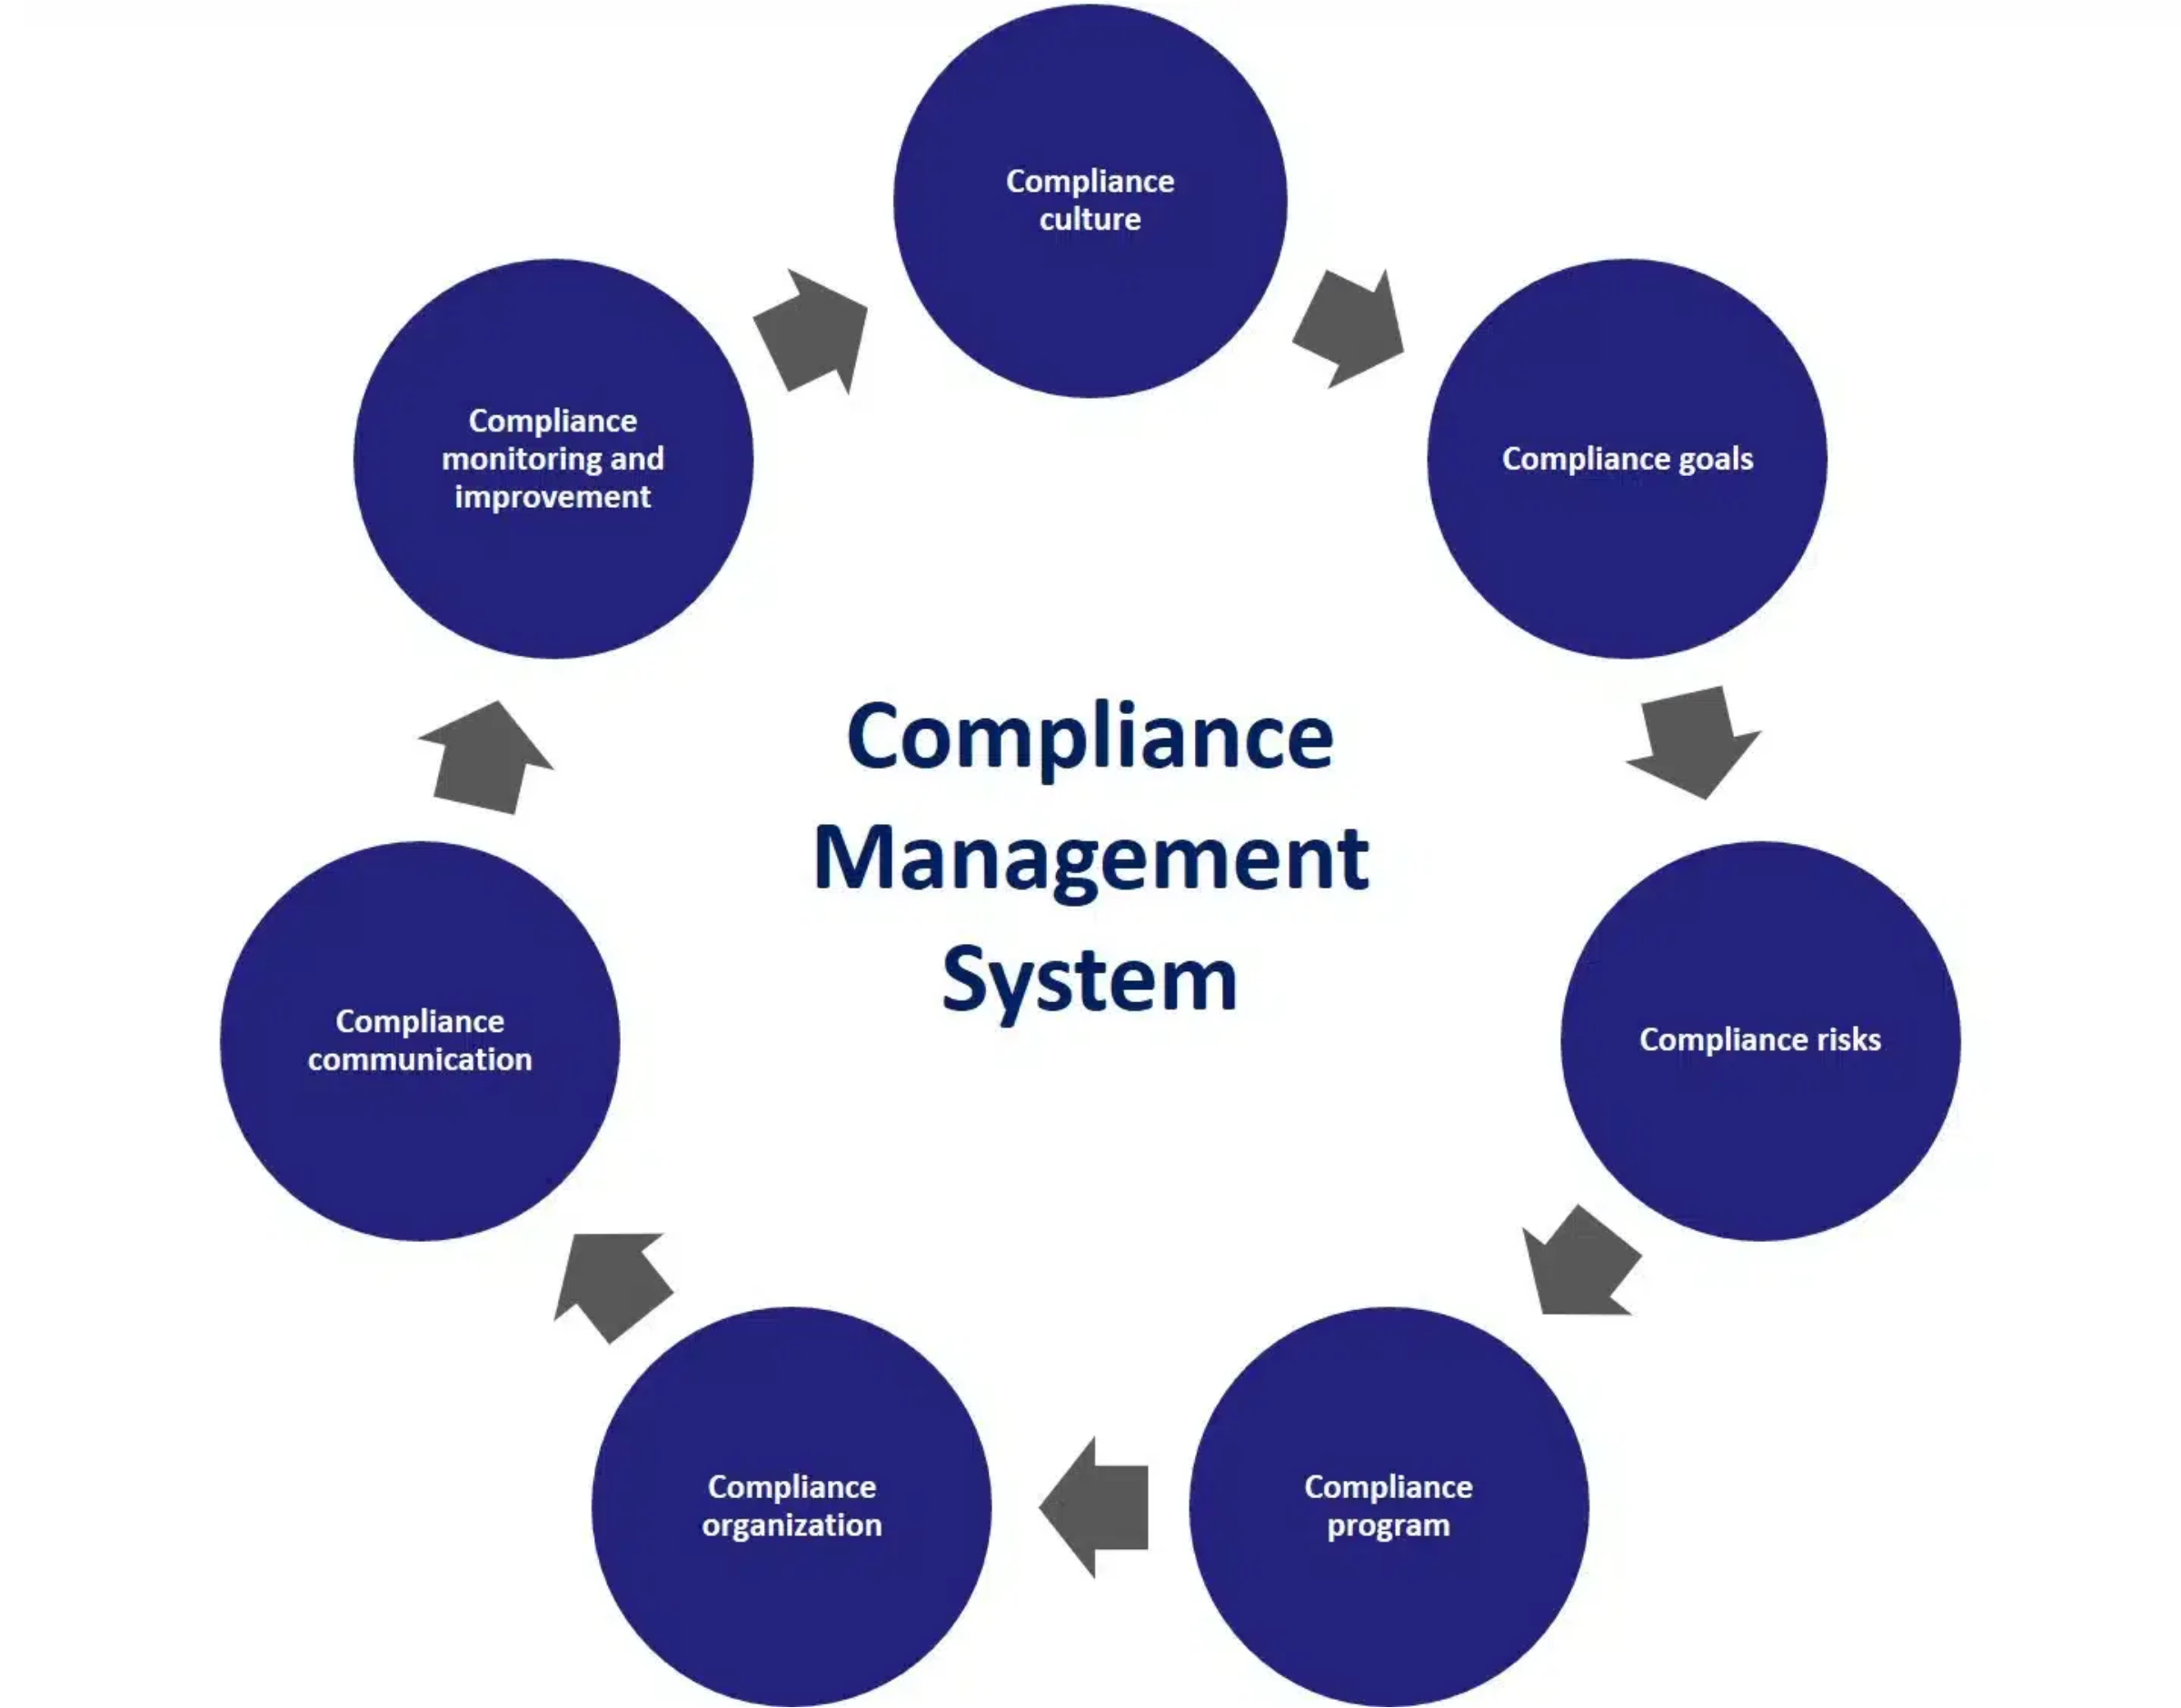





Compliance Management Overview
What is Compliance Management?
Compliance management is the ongoing process of monitoring and assessing systems, behaviors, and processes to ensure they meet relevant laws, policies, and regulations.
Key Components
An effective compliance management system integrates governance structures, risk management processes, and compliance controls to ensure regulatory adherence and ethical business practices.
Benefits of Effective Compliance Management
Reduced legal and regulatory risks
Avoided penalties and fines
Enhanced reputation and stakeholder trust
Improved operational efficiency
Better decision-making through data-driven insights

Slide 4

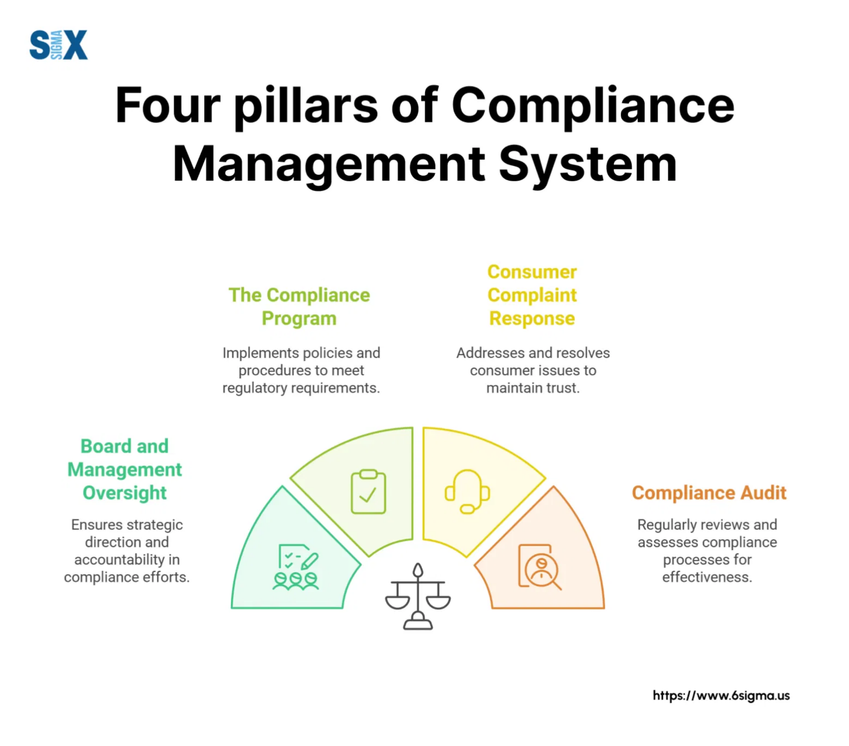




Compliance Management System Components
1. Board of Directors
Creates a culture of compliance from the top down and provides oversight to demonstrate the organization's commitment to compliance.
Develops and administers the compliance program
Communicates policies to senior management
Provides governance and accountability
2. Compliance Officer
Leads the compliance function and ensures effective management oversight, reporting directly to the Board.
Establishes and implements policies and procedures
Ensures staff training and evaluates emerging risks
Implements corrective actions as needed
3. Compliance Program
Risk assessments and employee training
Central hub for designing and implementing compliance controls, including structured policies, procedures, and practices.
Reporting mechanisms and monitoring systems
Audit procedures and response protocols

Slide 5
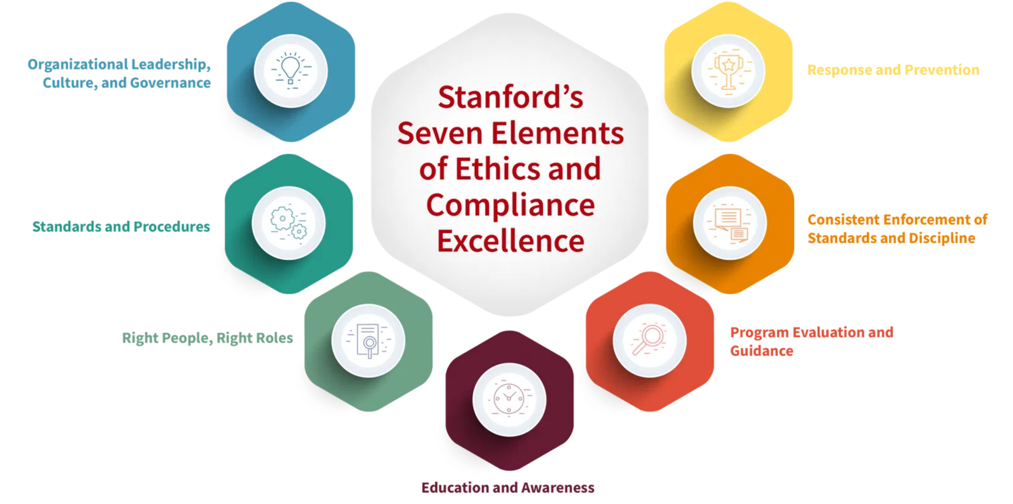
Seven Elements of an Effective Compliance Program
Based on U.S. Sentencing Guidelines
These seven elements form the foundation of an effective compliance program and are recognized by regulatory authorities worldwide.
1
Written Policies and Procedures
Standards of conduct, ethics policies, and specific procedural
guidance
2
Compliance Leadership
Designated compliance officer and compliance committee
with oversight authority
3
Training and Education
5
Monitoring and Auditing
Regular, comprehensive training programs for all employees
Regular assessment of compliance program effectiveness
and stakeholders
and risk areas
4
Effective Communication
6
Enforcement and Discipline
Open channels for reporting issues, including anonymous
Consistent application of disciplinary measures for
reporting options
compliance violations
7
Response and Prevention
Prompt investigation of issues and implementation of
corrective actions

Slide 6
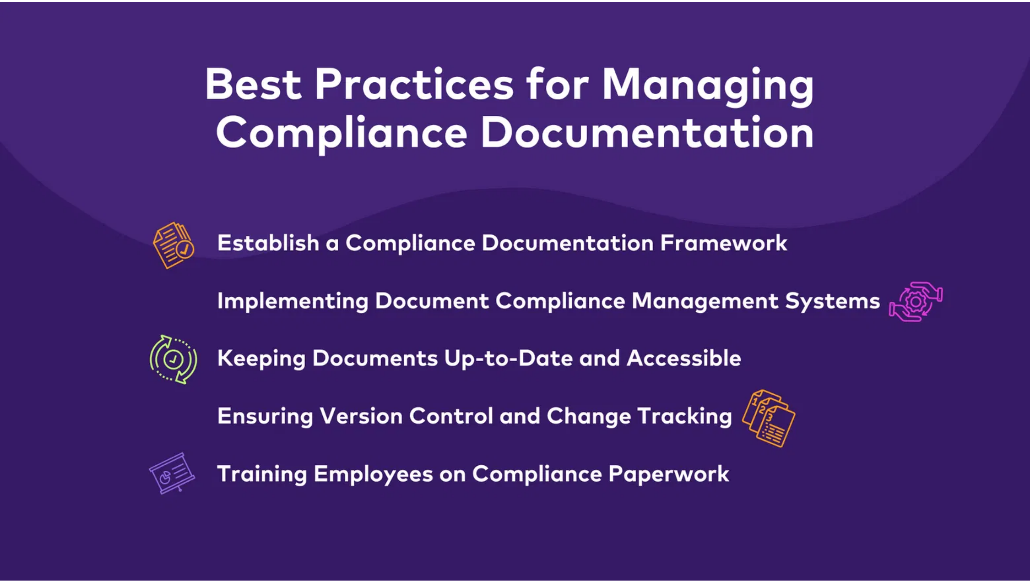





Compliance Policies and Procedures
Types of Compliance Policies
Code of Conduct
: Establishes ethical guidelines and
operating procedures for employees
Risk Management Policies
: Outlines strategies for
identifying, assessing, and mitigating risks
Data Privacy Policies
: Defines how personal and sensitive
data should be handled
Third-Party Policies
: Establishes requirements for vendor
relationships and due diligence
Policy Development Process
1
Identify regulatory requirements and organizational needs
Best Practice:
Policies should be clear, accessible, regularly
2
Draft policy with stakeholder input
updated, and reinforced through training
3
Review and approval by leadership
4
Implementation and communication
5
Regular review and updates

Slide 7
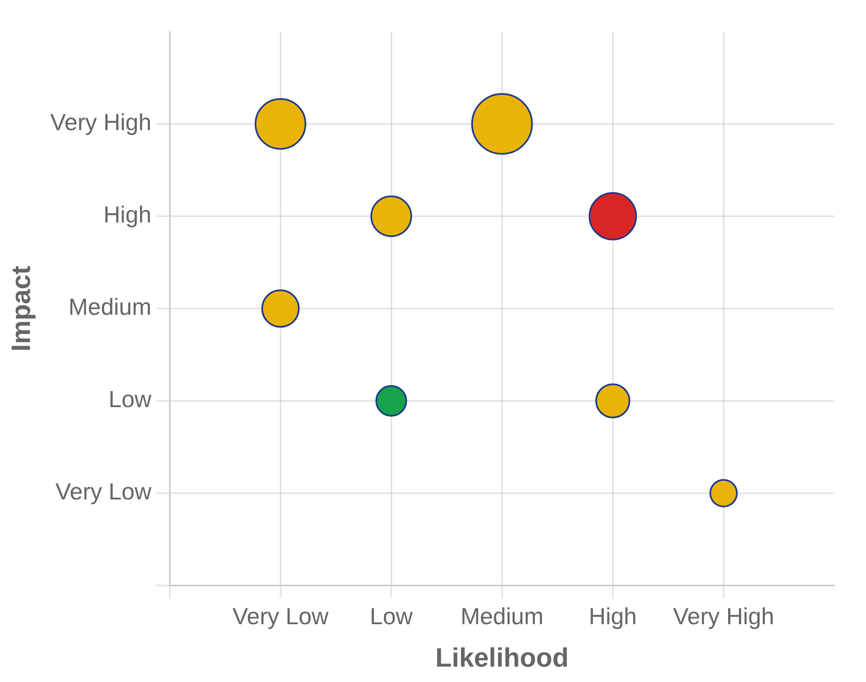





Compliance Risk Assessment
What is Compliance Risk Assessment?
Risk Assessment Matrix
Compliance risk assessment is the systematic process of identifying, analyzing, and evaluating potential compliance risks that could impact an organization's ability to meet regulatory requirements.
A risk matrix helps visualize and prioritize compliance risks based on their likelihood and potential impact.
Assessment Methodologies
Qualitative Assessment:
Uses descriptive scales (low, medium, high)
to evaluate risk likelihood and impact
Quantitative Assessment:
Uses numerical values and statistical
analysis to calculate risk levels
Semi-Quantitative Assessment:
Combines qualitative judgments
with numerical scoring systems
Control Self-Assessment:
Involves business units evaluating their
own compliance risks
Scenario Analysis:
Evaluates potential compliance failures and their
consequences

Slide 8
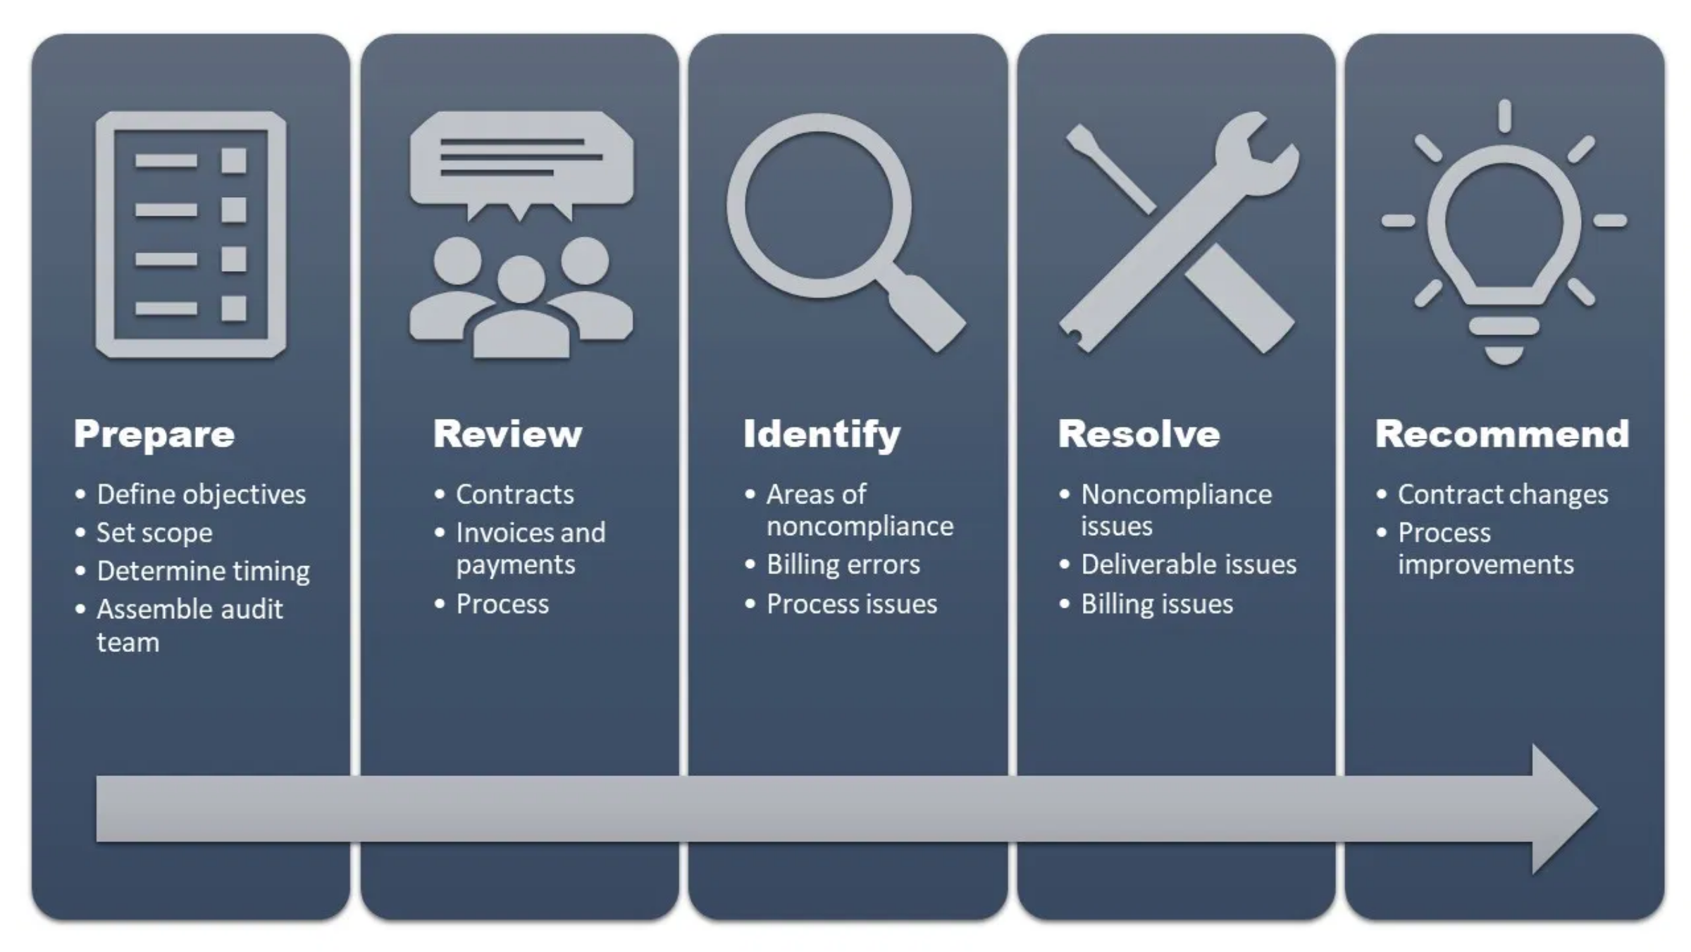

Compliance Monitoring and Auditing
Compliance Monitoring
Continuous process of reviewing and evaluating organizational activities to ensure ongoing compliance with regulatory requirements and internal policies.
Implement risk-based monitoring approach
Establish clear monitoring metrics and KPIs
Leverage automation tools for real-time monitoring
Compliance Auditing
3
Analysis
: Evaluate findings against compliance
Systematic, independent examination to determine whether compliance activities meet planned arrangements and regulatory requirements.
requirements
4
Reporting
: Document findings, recommendations, and
action plans
1
Planning
: Define scope, objectives, and methodology
5
Follow-up
: Verify implementation of corrective actions
2
Fieldwork
: Collect evidence through documentation review,
interviews, and testing

Slide 9
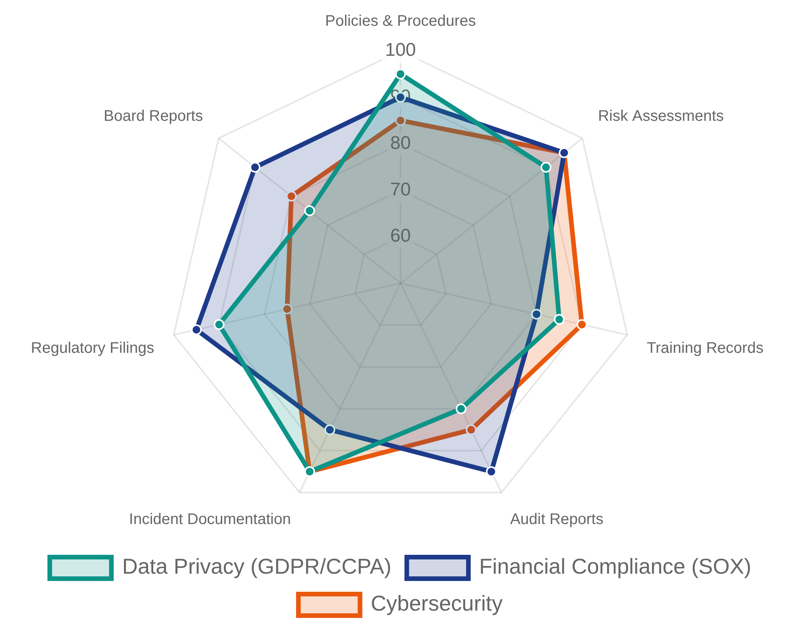






Compliance Documentation Requirements
Essential Documentation Categories
Documentation Importance by Regulatory Area
Comprehensive documentation is critical for demonstrating compliance with regulatory requirements and internal policies.
Governance Documents
Reporting Documents
Code of Conduct and Ethics Policy
Compliance Monitoring Reports
Compliance Program Charter
Audit Reports and Findings
Board and Committee Meeting Minutes
Regulatory Filings and Submissions
Operational Documents
Standard Operating Procedures (SOPs)
Work Instructions and Process Maps
Control Documentation and Testing Results
Risk Management Documents
Risk Assessment Reports
Documentation Best Practice:
Implement a centralized
Risk Registers and Mitigation Plans
document management system with version control, access
Incident Response Documentation
controls, and retention policies

Slide 10
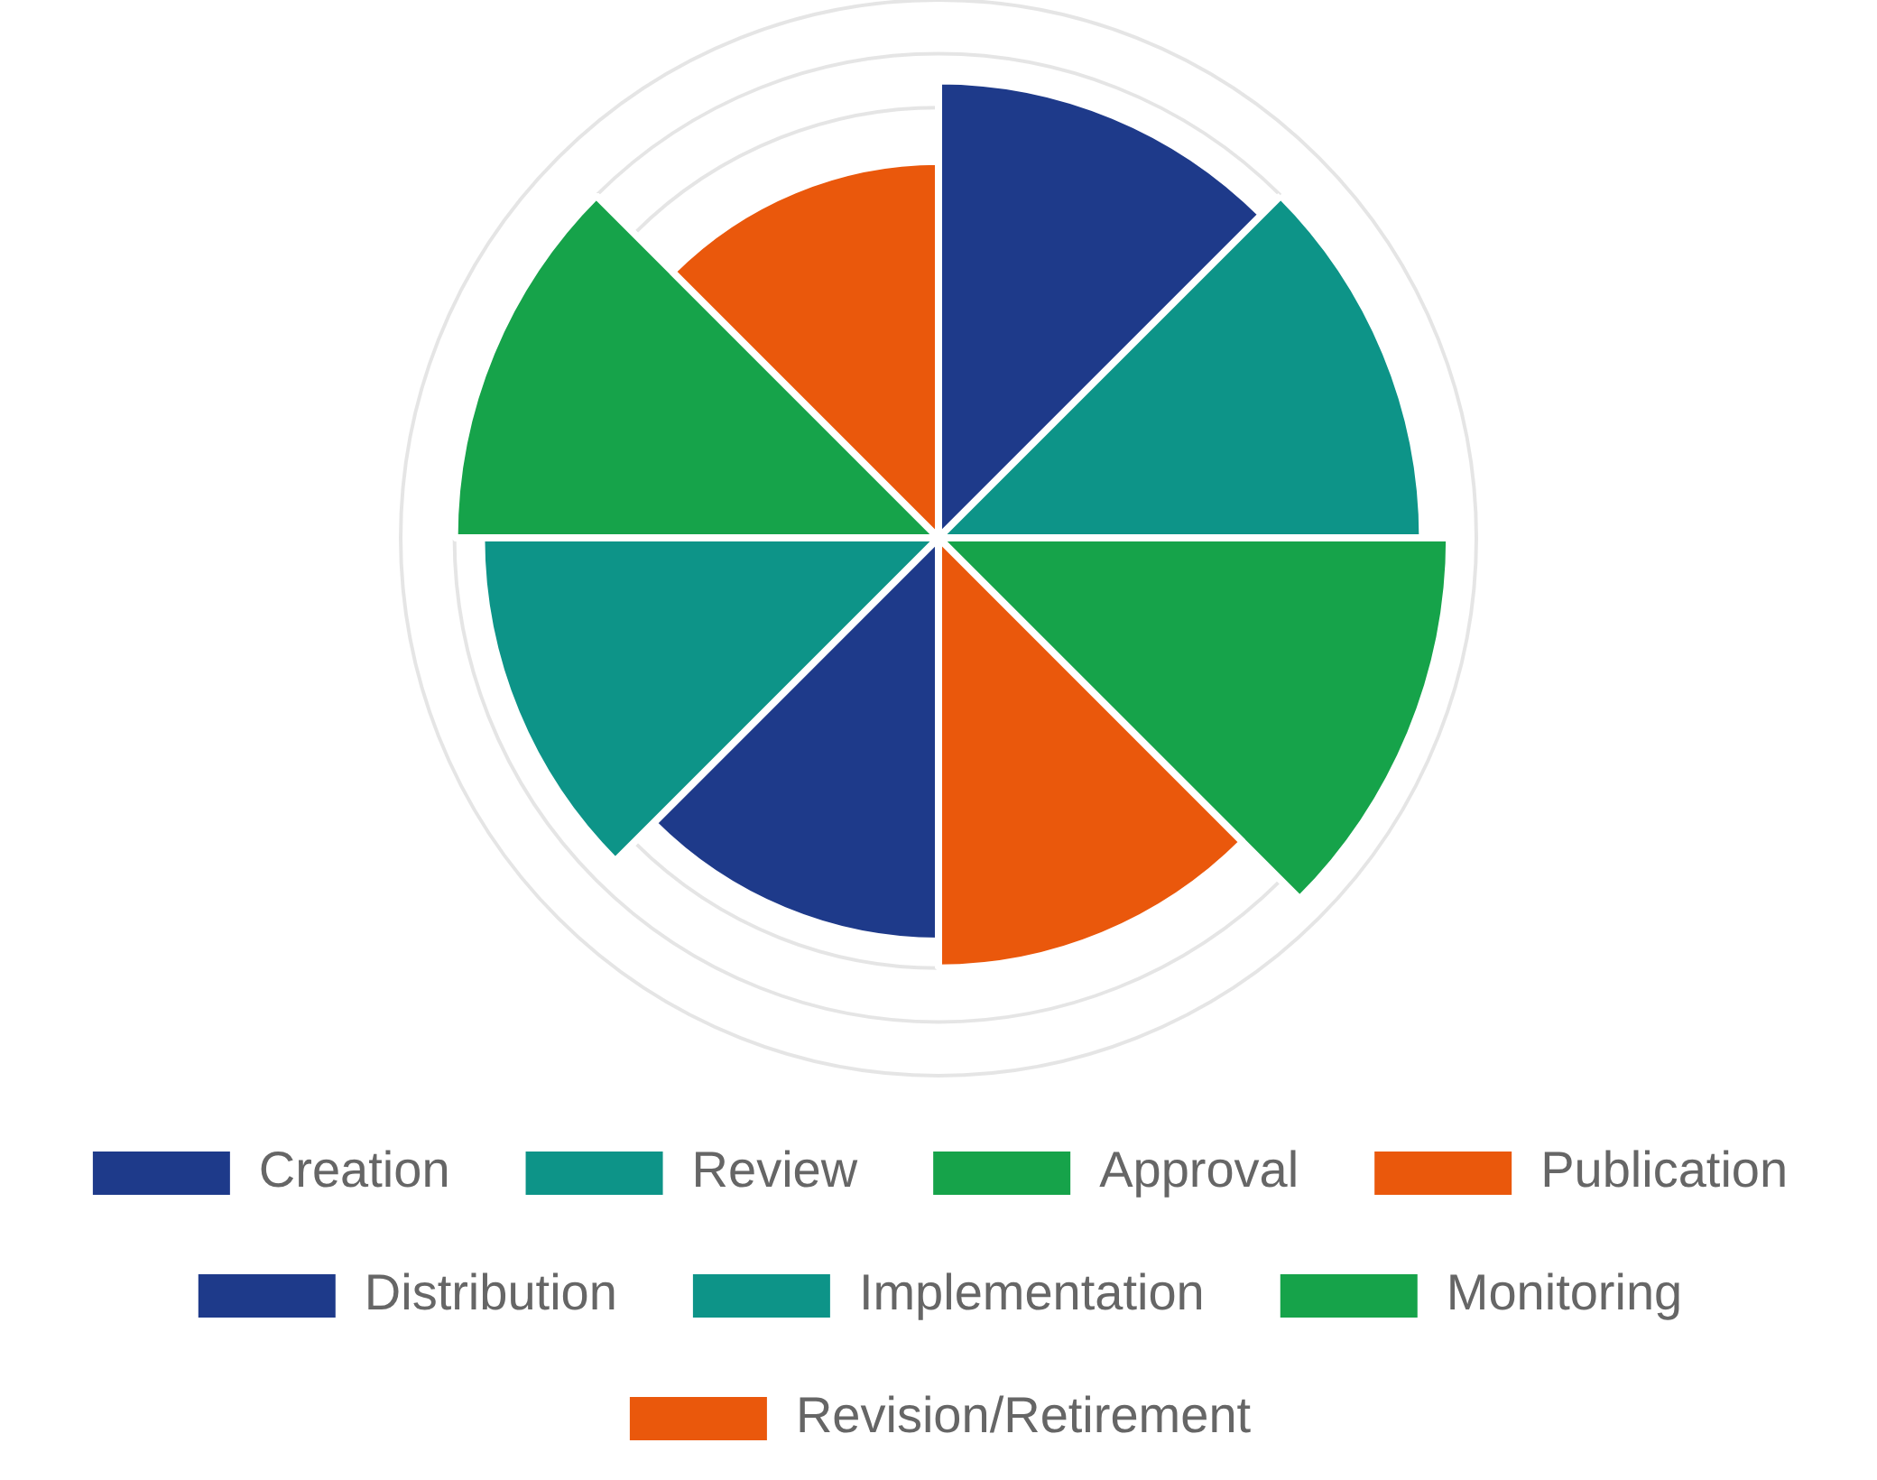







Compliance Documentation Management
Documentation Management Best Practices
Document Lifecycle Management
Understanding the complete lifecycle of compliance documentation helps ensure proper management at each stage.
Effective management of compliance documentation ensures accessibility, accuracy, and auditability throughout the document lifecycle.
Centralized Repository:
Implement a single source of truth
for all compliance documentation with appropriate access
controls
Metadata and Classification:
Tag documents with relevant
metadata (owner, date, version) and classify by type,
regulation, and risk level
Version Control:
Maintain document history with clear audit
trails of changes, approvals, and rationale
Review Schedules:
Establish regular review cycles based on
document criticality and regulatory requirements
Searchability:
Ensure documents are easily searchable with
Pro Tip:
Implement a document management system
robust indexing and full-text search capabilities
(DMS) that automates workflows, notifications, and
Security Controls:
Implement appropriate security measures
retention schedules
to protect sensitive compliance information

Slide 11
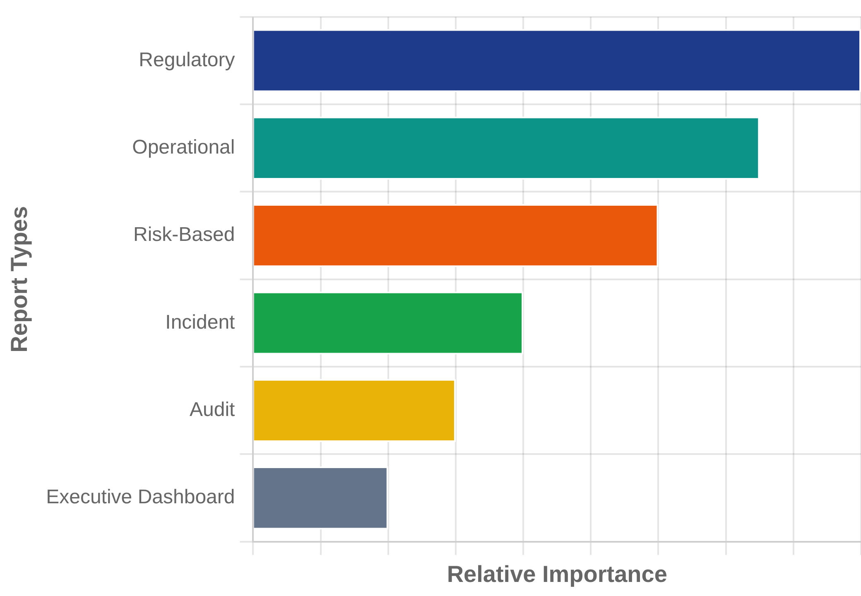








Compliance Reporting Fundamentals
Purpose of Compliance Reporting
Types of Compliance Reports
Compliance reporting provides structured information about an organization's adherence to regulatory requirements, internal policies, and industry standards.
Key Audiences
Board of Directors
: High-level compliance status and significant
risks
Executive Management
: Detailed program performance and
emerging issues
Effective Reporting Principles
Regulators
: Mandatory reporting on specific compliance
Relevance
: Tailored to audience needs and decision-making
requirements
requirements
Business Units
: Operational compliance metrics and action items
Data-Driven
: Based on measurable metrics and key
performance indicators
External Stakeholders
: Public disclosures and certifications
Timeliness
: Delivered with appropriate frequency to
support decision-making

Slide 12
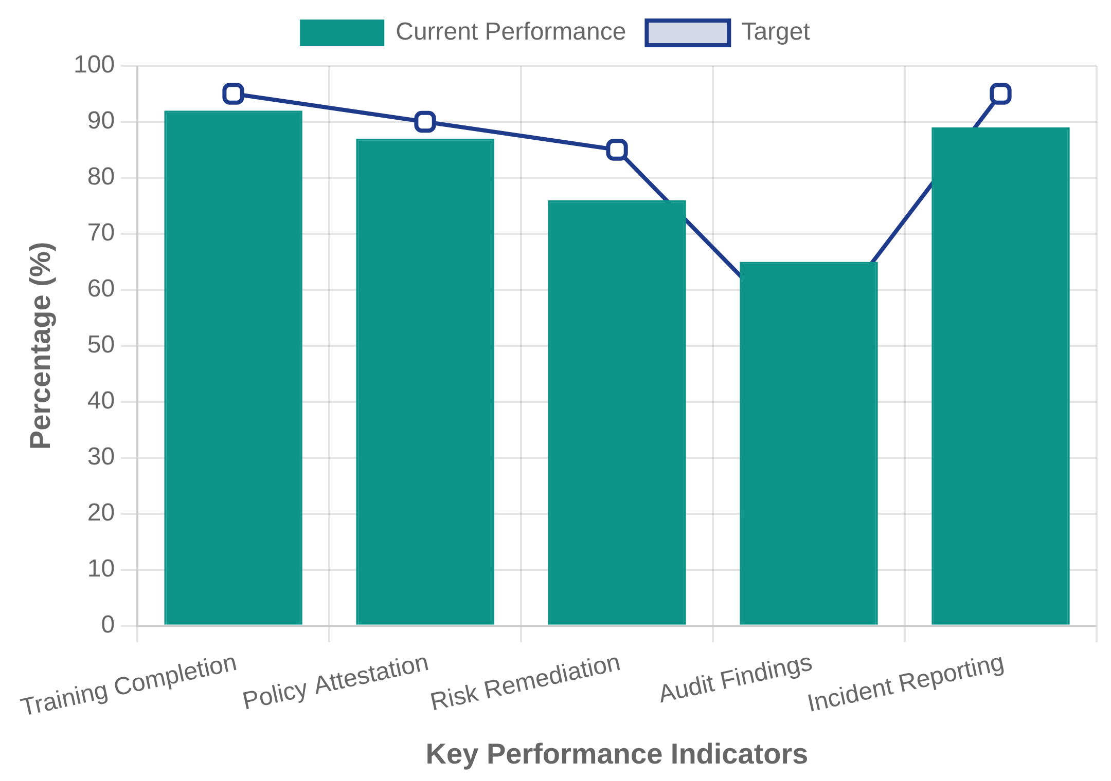



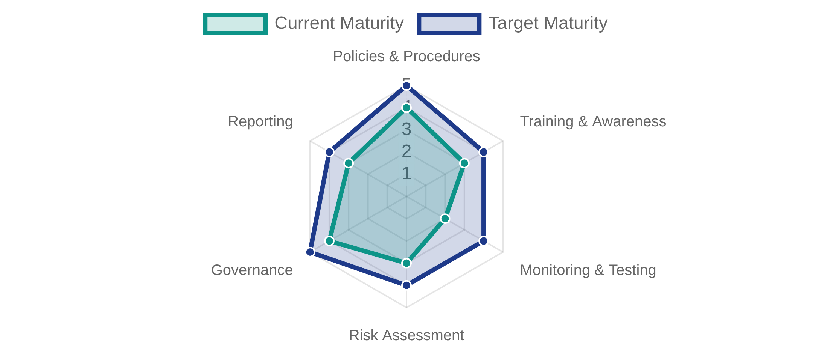


Compliance Metrics and KPIs
Why Measure Compliance?
Sample Compliance KPI Dashboard
Effective metrics and KPIs help organizations track compliance program effectiveness, identify improvement areas, and demonstrate value to stakeholders.
Key Compliance Metrics Categories
Process Metrics
: Measure the execution of compliance
activities (e.g., policy attestation rates, training completion
rates)
Risk Metrics
: Measure compliance risk levels (e.g., number of
high-risk findings, time to remediate issues)
Compliance Program Maturity by Domain
Outcome Metrics
: Measure the results of compliance efforts
(e.g., reduction in violations, audit findings)
Financial Metrics
: Measure financial impact (e.g., cost of
compliance, penalties avoided, ROI)
Cultural Metrics
: Measure compliance awareness and
attitudes (e.g., employee survey results, reporting rates)

Slide 13
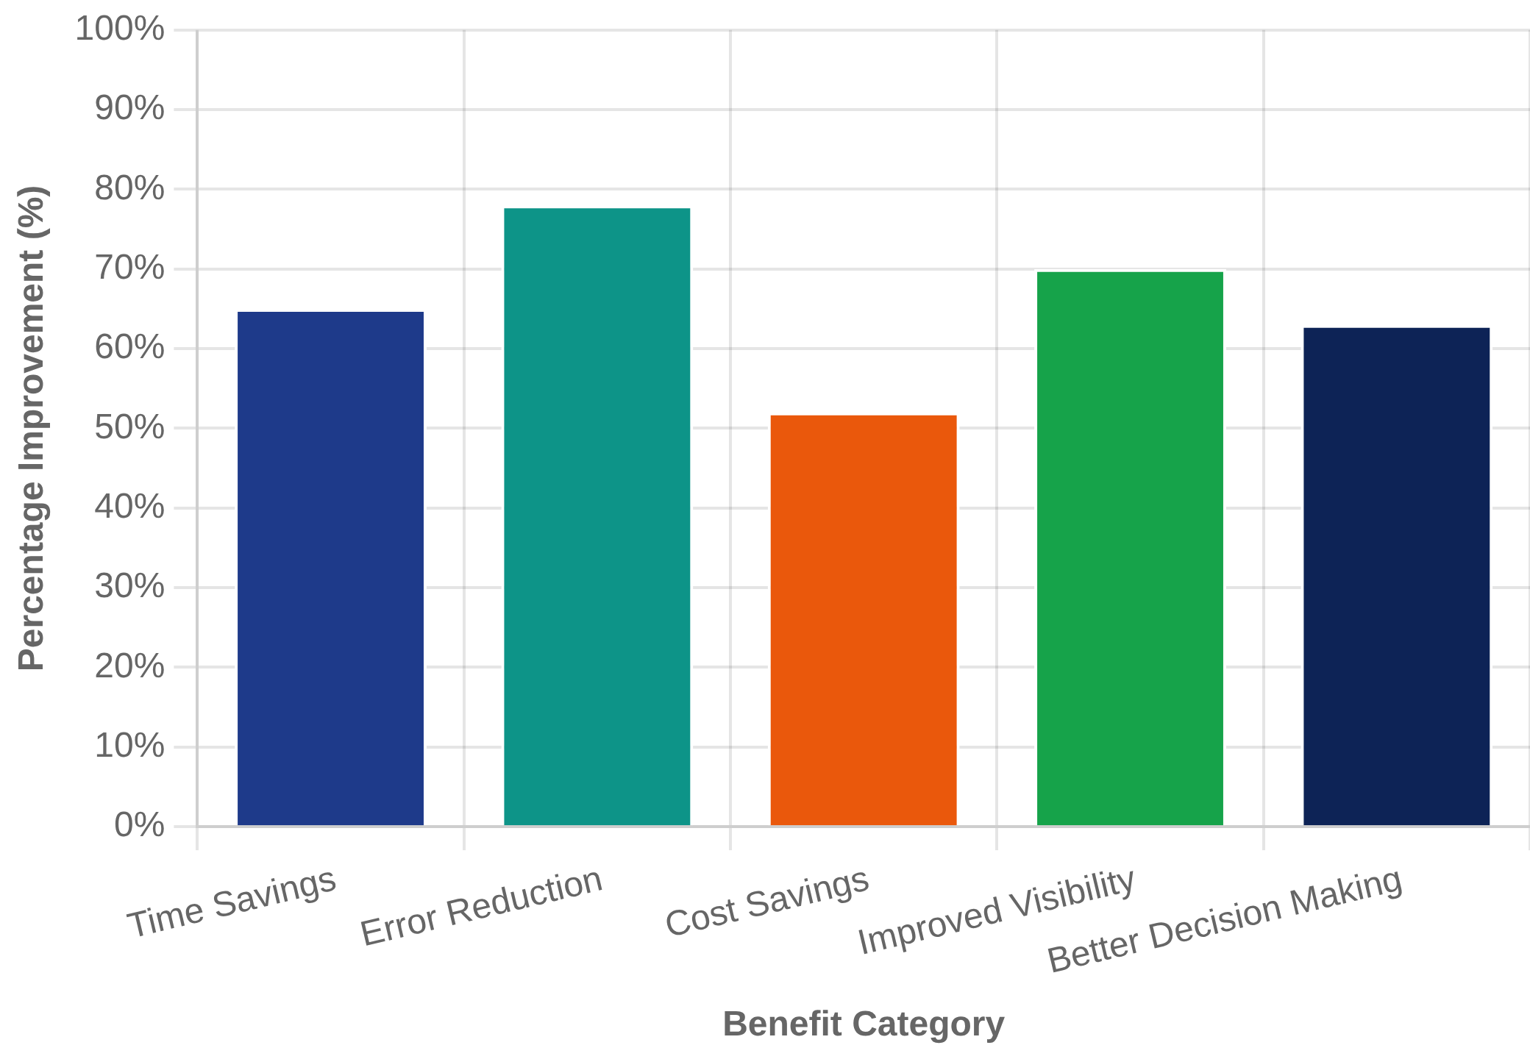
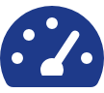




Compliance Reporting Tools and Technologies
Modern Compliance Solutions
Technology Adoption Benefits
Technology solutions that streamline compliance reporting, monitoring, and documentation management.
GRC Platforms
Integrated solutions that manage governance, risk, and compliance activities in a single platform
Automated Compliance Monitoring
Real-time monitoring tools that automatically detect compliance violations and trigger alerts
Analytics and Reporting Dashboards
Key Features to Look For
Visual dashboards that provide real-time compliance metrics and KPIs for decision-making
Customizable reporting templates
Audit trail capabilities
Cloud-Based Compliance Solutions
Integration with existing systems
Automated data collection
Scalable platforms that provide access to compliance tools and data from anywhere
Regulatory update tracking
Role-based access controls

Slide 14
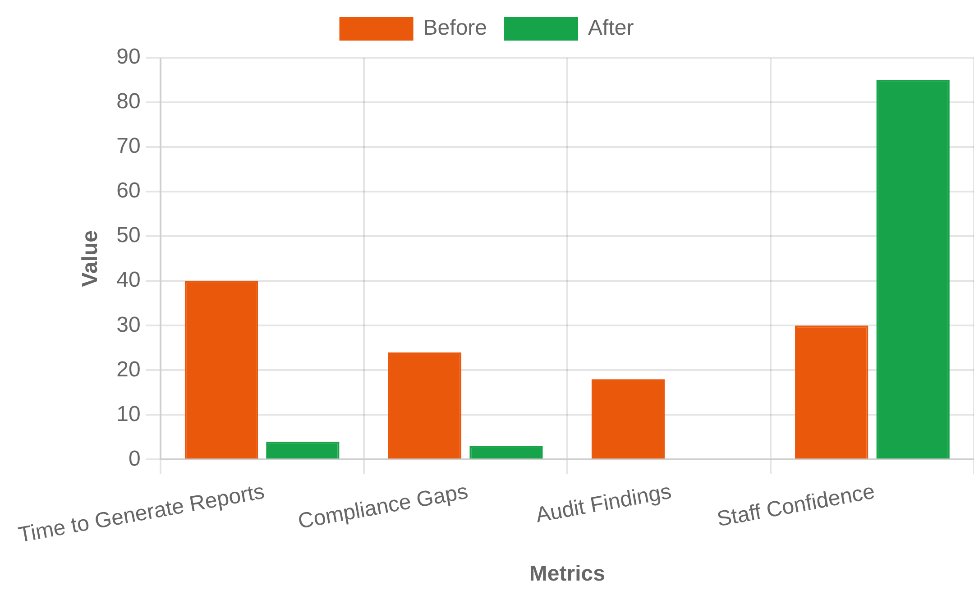



Case Study: Effective Compliance Reporting
Before vs. After Implementation
HealthTech Solutions, Inc.
A mid-sized healthcare technology company that needed to improve its compliance reporting system to meet HIPAA requirements and prepare for rapid growth.
Implementation Approach
1
Assessment
Evaluated existing compliance documentation and reporting
processes, identifying significant gaps in HIPAA compliance
tracking
2
Design
Lessons Learned
Developed standardized reporting templates and
Key takeaways from HealthTech's successful compliance reporting transformation:
established key metrics aligned with HIPAA requirements
3
Implementation
Deployed a GRC platform with automated data collection
Do
Don't
and customized dashboards for different stakeholders
Start with clear metrics aligned to regulatory requirements
Overwhelm reports with unnecessary data
4
Training & Adoption
Conducted role-based training and established a compliance
Implement technology without process improvement
reporting schedule with clear responsibilities
Customize reports for different stakeholder needs
Key Outcomes
Automate data collection where possible
Neglect training and change management
90% reduction in compliance reporting time
Establish regular reporting cadence
Forget to validate data accuracy
Passed HIPAA audit with zero major findings
Improved executive visibility into compliance status
Established proactive compliance culture

Slide 15
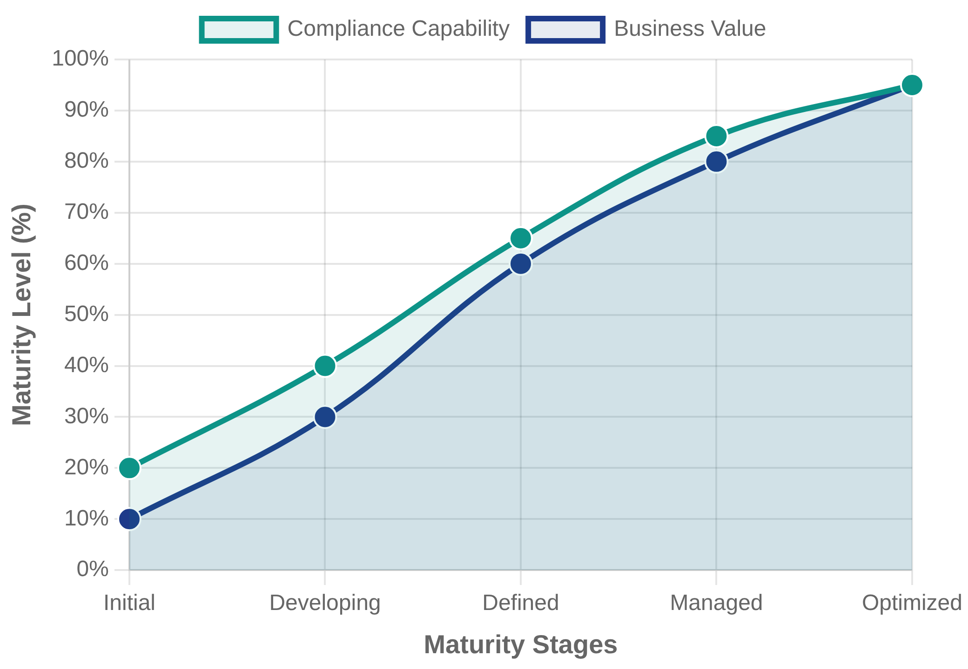




Summary and Next Steps
Week 4 Key Takeaways
Compliance Management Maturity Journey
This week covered the essential components of compliance management and reporting, providing a foundation for effective compliance programs.
Compliance Management System
consists of three main
components: Board of Directors, Compliance Officer, and
Compliance Program
Seven Elements of an Effective Compliance Program
provide a framework for building and evaluating compliance
efforts
Documentation Requirements
vary by regulatory area but
are essential for demonstrating compliance to stakeholders
Compliance Reporting
should be tailored to specific
audiences and include relevant metrics and KPIs
Technology Solutions
can significantly improve compliance
management efficiency and effectiveness

